Slide 1





EgQCC
Quantum Security Triangle
QUANTUM
COMMUNICATION (QC)
FOUNDATIONS, PROTOCOLS, AND SIMULATION FRAMEWORKS
The Physical Layer

Slide 2

WHY
QUANTUM
COMMUNICATION
Classical cryptographic systems rely on computational hardness assumptions
Quantum computers threaten widely deployed schemes (RSA, ECC, DH)
Quantum Communication offers information-theoretic security
Security is guaranteed by fundamental laws of quantum mechanics, not assumptions
This represents a paradigm shift from computational security to physical security.
Salford & Co.

Slide 3
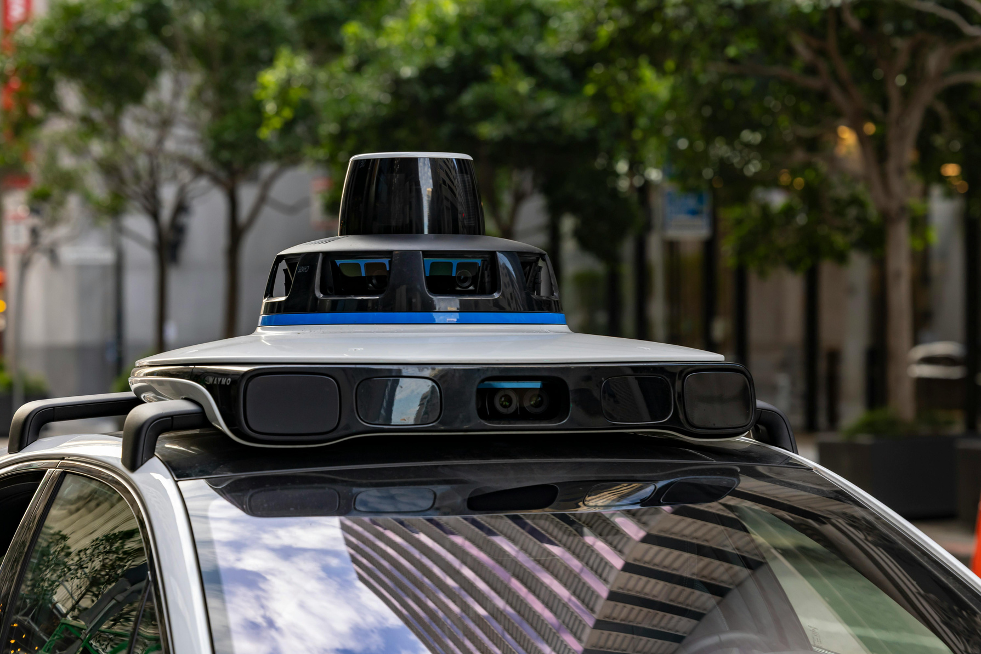
Definition
Quantum Communication is the study and implementation of communication systems that use quantum states (typically photons) to transmit information securely.
WHAT IS QUANTUM COMMUNICATION
Key Properties:
No-cloning theorem
Measurement disturbance
Quantum superposition and entanglement
These properties enable intrinsic eavesdropping detection.
Quantum Communication – Physical Layer
EGQCC

Slide 4
WHY THE PHYSICAL LAYER MATTERS
In classical networks, the physical layer is mostly security-agnostic
In quantum communication:
Hardware directly impacts security
Noise, loss, and detector efficiency affect correctness
Security cannot be abstracted away from implementation
Quantum security begins at the photon level.
Quantum Communication – Physical Layer
EGQCC

Slide 5
SCOPE OF THIS PRESENTATION
EGQCC
Quantum Key Distribution (QKD)
BB84 Protocol (Foundational QKD Scheme)
Quantum Temporal Authentication (QTA)
Quantum Secure Direct Communication (QSDC)
Quantum Network Simulation
NetSquid
QuNetSim

Slide 6

QUANTUM KEY DISTRIBUTION (QKD)
EGQCC
Quantum Key Distribution (QKD) is the most mature and widely studied application of quantum communication. Its primary objective is to enable two legitimate parties, commonly referred to as Alice and Bob, to establish a shared secret key over an insecure quantum channel in the presence of a potentially unbounded adversary, denoted as Eve.
Unlike classical key exchange mechanisms, whose security relies on computational assumptions, QKD provides information-theoretic security grounded in the laws of quantum mechanics. Even an adversary with unlimited computational resources cannot compromise the security of a correctly implemented QKD protocol without being detected.

Slide 7
QUANTUM KEY DISTRIBUTION (QKD)
EGQCC
Fundamental Principles of QKD
The security of QKD protocols is derived from several fundamental quantum mechanical principles:
Quantum Superposition: Quantum states can exist in linear combinations of basis states, enabling the encoding of information in non-orthogonal states.
Measurement Disturbance: Any measurement performed on an unknown quantum state generally alters that state, introducing detectable errors.
No-Cloning Theorem: It is physically impossible to create an identical copy of an arbitrary unknown quantum state.
Intrinsic Randomness: Quantum measurement outcomes are fundamentally probabilistic, enabling true randomness generation.
These principles collectively ensure that eavesdropping attempts necessarily leave observable traces in the quantum channel.
General QKD Architecture
A typical QKD system consists of two logically distinct channels:
Quantum Channel: Used for transmitting quantum states (e.g., photons) encoding raw key material.
Classical Channel: Used for public communication related to basis reconciliation, error correction, and privacy amplification.
While the quantum channel is assumed to be insecure and fully accessible to the adversary, the classical channel is required to be authenticated but not confidential. Authentication prevents active man-in-the-middle attacks during classical post-processing.

Slide 8
QUANTUM KEY DISTRIBUTION (QKD)
EGQCC
Threat Model and Security Assumptions
QKD typically assumes a powerful adversary with the following capabilities:
Full control over the quantum and classical channels
Unlimited computational power
Ability to perform arbitrary quantum operations
The only constraints imposed on the adversary are those dictated by the laws of quantum mechanics. This adversary model ensures that security proofs are robust and future-proof.
Limitations and Practical Challenges
Despite its strong theoretical guarantees, QKD faces several practical limitations:
Channel loss and decoherence
Imperfect photon sources and detectors
Finite key effects
Distance and scalability constraints
These challenges motivate the need for careful physical-layer design and realistic performance evaluation, which will be addressed in later sections.

Slide 9
QUANTUM KEY DISTRIBUTION (QKD)
EGQCC
The BB84 Quantum Key Distribution Protocol
Focus: Prepare and Measure mechanics, QBER monitoring, Privacy Amplification
The BB84 protocol (Bennett & Brassard, 1984)
is the foundational quantum key distribution protocol enabling secure key generation through quantum mechanics. BB84 implements three critical security mechanisms for Phase 3:
Prepare and Measure Mechanics: Quantum state preparation and measurement-based key generation
QBER Monitoring: Real-time quantum bit error rate measurement for intrusion detection
Privacy Amplification: Post-processing techniques to clean the shared key
BB84 demonstrates how quantum mechanics prevents eavesdropping through the no-cloning theorem and measurement uncertainty, establishing keys with information-theoretic security (unconditional against quantum computers).
Prepare and Measure Mechanics
BB84 uses the prepare-and-measure paradigm: Alice prepares quantum states, transmits them over an insecure quantum channel, and Bob measures them using randomly chosen bases. This asymmetry provides security.
Quantum State Encoding
In BB84, information is encoded using two mutually unbiased bases (MUBs). For photon polarization implementations, these bases are typically:
Rectilinear Basis (Z): {|0⟩, |1⟩}
Diagonal Basis (X): {|+⟩, |-⟩}

Slide 10
QUANTUM KEY DISTRIBUTION (QKD)
EGQCC
The BB84 Quantum Key Distribution Protocol
Protocol Description
The BB84 protocol proceeds as follows:
Alice randomly selects a bit string and a sequence of encoding bases.
Alice prepares quantum states accordingly and transmits them to Bob.
Bob randomly selects measurement bases and measures incoming states.
Alice and Bob publicly compare bases over the classical channel.
Bits corresponding to matching bases are retained (sifting).
At this stage, Alice and Bob share a raw key that may contain errors due to noise or eavesdropping.

Slide 11
QUANTUM KEY DISTRIBUTION (QKD)
EGQCC
The BB84 Quantum Key Distribution Protocol
Eavesdropping Detection and QBER Monitoring
The BB84 protocol detects eavesdropping through Quantum Bit Error Rate (QBER) analysis. After sifting, Alice and Bob publicly compare a random subset of their raw key bits. If an eavesdropper (Eve) has been monitoring the channel:
Eve must measure each quantum state in a randomly chosen basis
Eve will measure in the wrong basis roughly 50% of the time
Wrong measurements produce random outcomes with 50% error rate
Alice and Bob will observe QBER significantly above the quantum noise floor
The theoretical QBER threshold is:
If measured QBER exceeds this threshold, eavesdropping is detected and the protocol is aborted.

Slide 12
QUANTUM KEY DISTRIBUTION (QKD)
EGQCC
The BB84 Quantum Key Distribution Protocol
Privacy Amplification
Even with no detected eavesdropping, the raw key may contain information leaked to Eve through:
Quantum channel losses that are correlated with measurement outcomes
Partial information gained through beam-splitting attacks
Side-channel leakage from measurement apparatus
Privacy amplification removes this residual information through post-processing:
Parity-Check Codes
The sifted key is divided into blocks. New key bits are generated as:
Where ⊕ denotes XOR operation and m is the block size. This reduces Eve's knowledge exponentially with the block size.
Toeplitz Matrices
Alternatively, random Toeplitz matrices are applied to the raw key for stronger security:
This provides provably secure privacy amplification with exponential information removal.

Slide 13
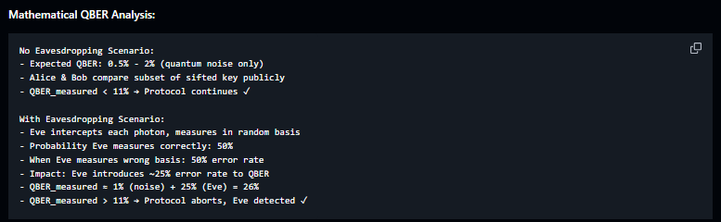
QUANTUM KEY DISTRIBUTION (QKD)
The BB84 Quantum Key Distribution Protocol
EGQCC
Security Intuition
An eavesdropper attempting to intercept and resend quantum states must perform measurements. Due to basis mismatch, this introduces errors that manifest as an increased Quantum Bit Error Rate (QBER).
By publicly comparing a subset of their raw key, Alice and Bob can estimate the QBER. If the observed error rate exceeds a predefined threshold, the protocol is aborted.
The security of BB84 relies on the fundamental impossibility of simultaneously measuring non-commuting observables without disturbance. Any attempt by an adversary to gain information about the key inevitably introduces detectable errors.
Security proofs of BB84 show that, below a certain QBER threshold, Alice and Bob can apply error correction and privacy amplification to distill a secret key that is statistically independent of the adversary's information.

Slide 14

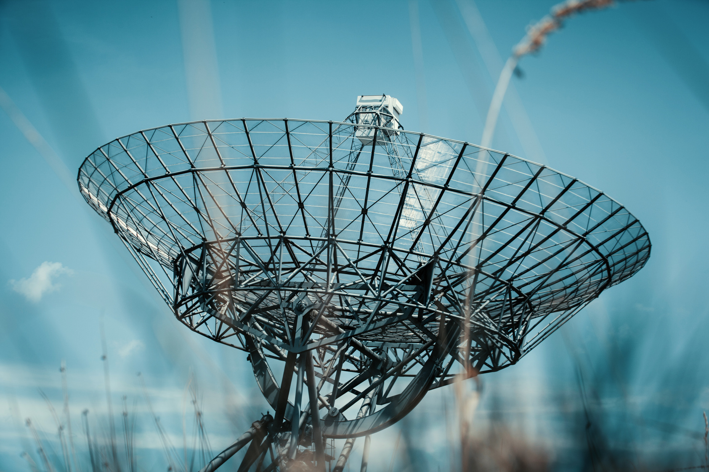
QUANTUM TEMPORAL AUTHENTICATION (QTA)
Focus: Temporal Binding, Time-of-Arrival (ToA), Verification Challenges
EGQCC

Slide 15
QUANTUM TEMPORAL
AUTHENTICATION (QTA)
Quantum Temporal Authentication (QTA) is an emerging quantum communication primitive that leverages ultra-precise quantum timing and speed-of-light constraints for identity verification and impersonation prevention. QTA implements three critical Phase 3 security mechanisms:
Temporal Binding: Using nanosecond-scale Time-of-Arrival (ToA) measurement
Distance-Based Authentication: Speed-of-light constraints preventing MITM attacks
Verification Challenges: Time-based challenges resistant to quantum cloning
QTA provides unconditional authentication by making it physically impossible for an eavesdropper to mimic legitimate communications without introducing detectable timing delays.
EGQCC

Slide 16
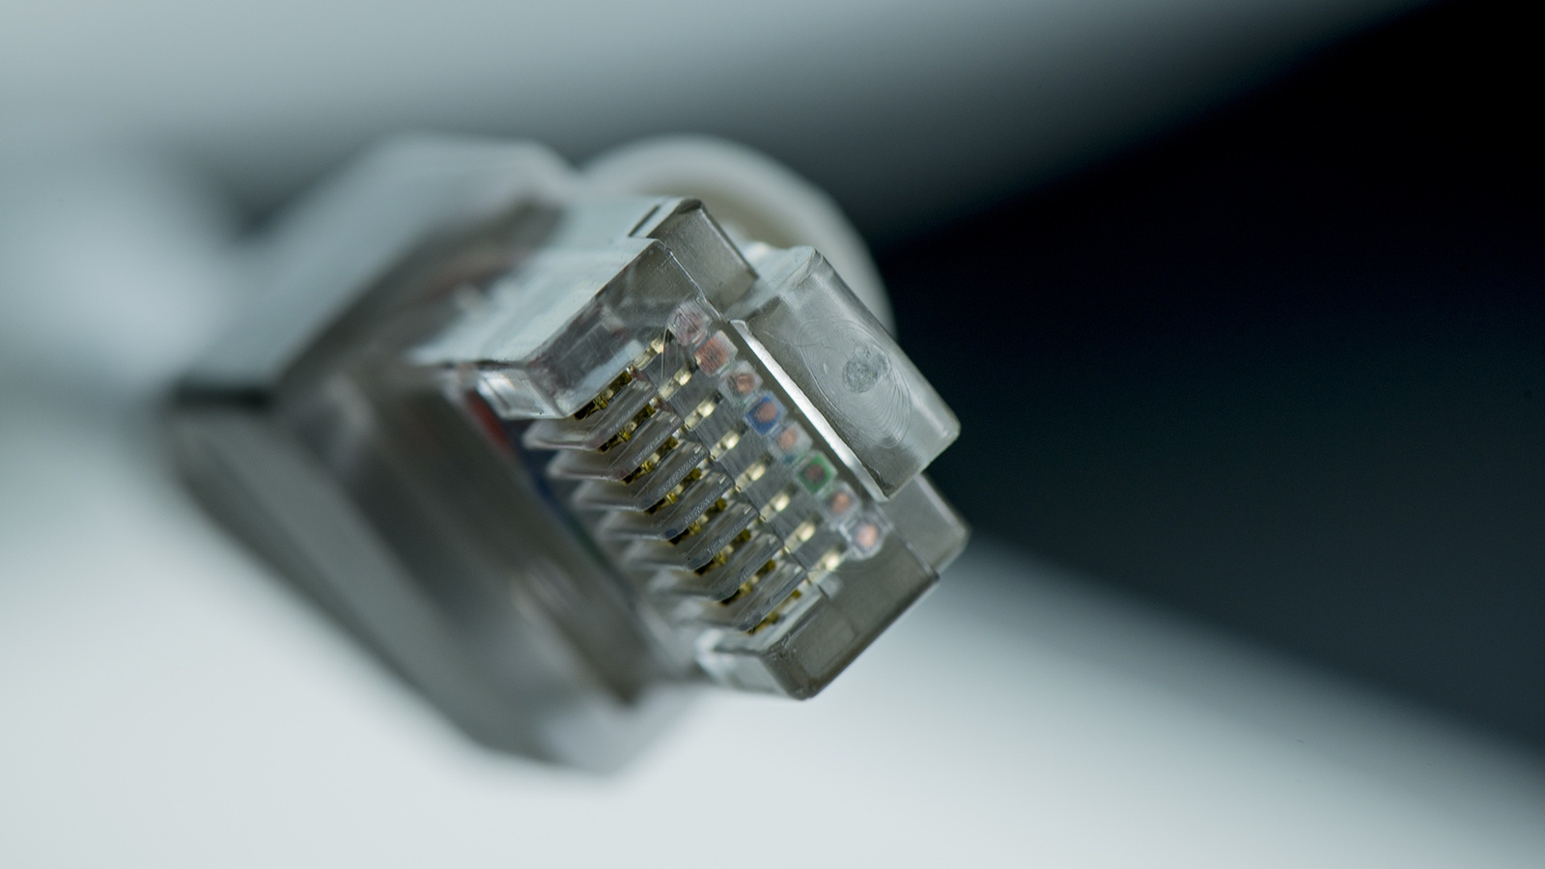
TEMPORAL BINDING
AND
TIME-OF-ARRIVAL (TOA)
QTA leverages the no-cloning theorem combined with physical transmission delays to bind quantum states to specific spatial-temporal locations. By measuring the precise arrival time of quantum signals at the speed of light, legitimate communicators can authenticate each other's physical locations.
Motivation
Classical authentication relies on shared secrets or public-key infrastructure, both vulnerable to quantum computers. QTA introduces authentication mechanisms that exploit quantum timing constraints rather than cryptographic assumptions.
EGQCC

Slide 17

QUANTUM
SECURE DIRECT
COMMUNICATION
(QSDC)
Quantum Secure Direct Communication (QSDC)
EGQCC
Quantum Secure Direct Communication (QSDC) is a Phase 3 protocol enabling direct secure transmission of data over quantum channels without prior key distribution.
QSDC implements three critical Phase 3 mechanisms:
No Prior Key Distribution: Message transmission directly over quantum channel without pre-shared keys
Security Checking Phase: Multi-phase channel verification before bulk message transmission
Direct Secure Transmission: 425-850 kbps throughput with information-theoretic security
QSDC addresses the fundamental QKD limitation of needing separate classical channels and long-term key storage. By encoding messages directly in quantum states, QSDC eliminates key management complexity and provides unconditional security.

Slide 18
QUANTUM
SECURE DIRECT
COMMUNICATION
(QSDC)
Motivation for QSDC
EGQCC
Traditional QKD requires separate classical channels for message transmission after key establishment. QSDC eliminates this limitation by enabling direct quantum communication:
Direct Message Transmission: Quantum channel serves as both secure medium and key distribution channel
Unconditional Security: Information-theoretic security resistant to quantum computers and computational advances
Reduced Key Storage: No long-term key storage requirements, eliminating side-channel vulnerabilities
Practical Efficiency: By combining key distribution and message transmission in a single protocol, QSDC reduces the total number of quantum transmissions required.
The motivation for QSDC is particularly relevant in scenarios where secure communication must occur between parties without prior shared secrets, and where the communication bandwidth is limited or the infrastructure cost must be minimized.

Slide 19
QUANTUM
SECURE DIRECT
COMMUNICATION
(QSDC)
Additional Advantages
EGQCC
Forward Secrecy: Even if an attacker gains access to all classical post-quantum computation, the messages transmitted through QSDC remain secure since no classical key material is stored that could be compromised later.
Single-Use Qubits: Unlike QKD where key bits must be accumulated over time, QSDC qubits encode single-use information, eliminating the need for key inventory management.
Lower Error Tolerance Requirements: QSDC protocols can tolerate slightly higher quantum bit error rates compared to QKD before eavesdropping is suspected, since some redundancy is inherent in the protocol design.
Resistance to Trojan-Horse Attacks: The direct encoding mechanism makes QSDC protocols more resistant to certain Trojan-horse style attacks compared to conventional QKD.

Slide 20
QUANTUM
SECURE DIRECT
COMMUNICATION
(QSDC)
Practical Application Scenarios
EGQCC
QSDC is particularly suited for:
Government and diplomatic communications requiring immediate secure transmission
Financial institutions transmitting sensitive transaction data
Military command and control systems where key pre-distribution is infeasible
Healthcare systems transmitting patient records with stringent privacy requirements
Research collaborations requiring secure real-time data sharing

Slide 21
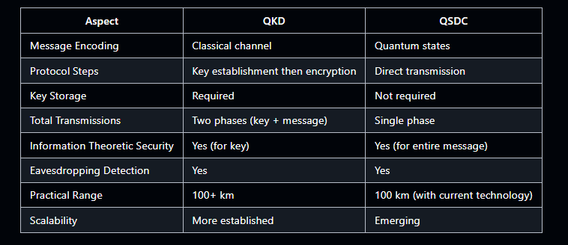
QUANTUM SECURE DIRECT COMMUNICATION (QSDC)
EGQCC
QSDC vs QKD
The key distinction is that QKD establishes a shared secret key through quantum means, which is then used to encrypt classical messages. QSDC, conversely, encodes the message directly into quantum states, transmitting the secret information through the quantum channel itself.

Slide 22
QUANTUM SECURE DIRECT COMMUNICATION (QSDC)
EGQCC
QSDC vs QKD
Detailed Protocol Comparison
Workflow Differences:
QKD: Quantum Transmission → Raw Key Sifting → Privacy Amplification → Key Storage → Message Encryption (Classical)
QSDC: Quantum Transmission with Encoding → Eavesdropping Detection → Direct Message Recovery
Complexity Analysis:
Time Complexity: QKD requires O(n) quantum transmissions for n-bit keys plus classical post-processing. QSDC requires O(m) quantum transmissions for m-bit messages, typically m < n.
Space Complexity: QKD requires secure storage of distributed keys, consuming O(n) memory. QSDC requires minimal storage, only for protocol parameters.
Communication Rounds: QKD: 2-3 rounds. QSDC: 2-4 rounds depending on protocol variant.
Hybrid Approaches
Modern implementations often combine QKD and QSDC:
Use QKD to establish initial authentication credentials
Deploy QSDC for actual message transmission
Periodically re-authenticate using QKD

Slide 23
QUANTUM SECURE DIRECT COMMUNICATION (QSDC)
EGQCC
Fundamental QSDC Protocols
Ping-Pong Protocol
The Ping-Pong protocol, proposed by Boström and Felbinger in 2002, is one of the earliest and most elegant QSDC protocols. The protocol operates as follows:
Qubit Preparation: Alice prepares a sequence of qubits in randomly chosen bases. Each qubit encodes the message bit where basis choice determines encoding.
First Transmission: Alice sends the qubits to Bob. Bob receives the sequence but does not measure immediately.
Echo-Back: Bob applies a unitary operation and returns the sequence to Alice. This preserves quantum information but can be detected if modified by an eavesdropper.
Basis Announcement: Alice reveals the basis used for each qubit.
Measurement: Alice publishes measurement results for eavesdropping detection.
Two-Step QSDC
The Two-Step protocol extends QSDC functionality by introducing an intermediate acknowledgment phase:
Initial State Preparation: Alice prepares entangled pairs and sends one half to Bob.
Bob's Measurement: Bob performs measurements on his qubits and announces the bases.
Alice's Encoding: Based on Bob's bases, Alice applies operations to encode the secret message.
Transfer and Recovery: Alice sends her qubits to Bob, who recovers the message.

Slide 24
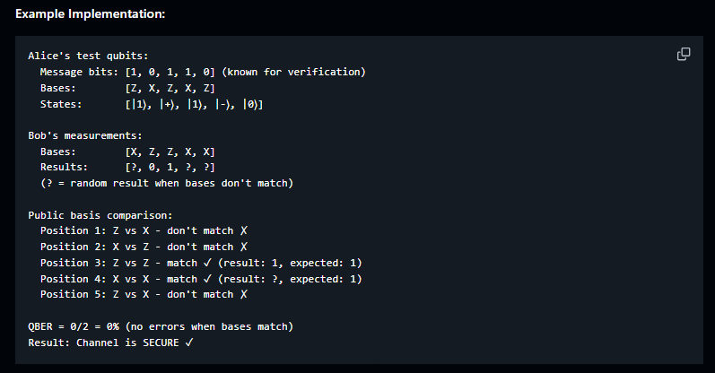
QUANTUM SECURE DIRECT COMMUNICATION (QSDC)
EGQCC
Security Checking Phase
Before transmitting the bulk message, QSDC includes a critical security verification phase:
Phase 1: Channel Establishment and Test Qubits
Alice prepares test qubits with known message bits
These are transmitted through the quantum channel to Bob
Bob measures using randomly chosen bases
Alice and Bob compare basis choices publicly
QBER is calculated from matching basis bits

Slide 25
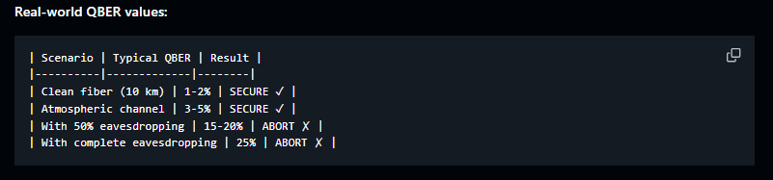
QUANTUM SECURE DIRECT COMMUNICATION (QSDC)
EGQCC
Security Checking Phase
Phase 2: QBER Threshold Verification
The measured QBER is compared against threshold:
If QBER < Q_threshold: Channel is secure, proceed to Phase 3 ✓
If QBER ≥ Q_threshold: Eavesdropping suspected, abort protocol ✗

Slide 26
QUANTUM SECURE DIRECT COMMUNICATION (QSDC)
EGQCC
Security Checking Phase
Phase 3: Authentication and Bulk Message Transmission
Once security is verified:
Alice transmits message-bearing qubits with authentication tags
Each qubit includes a quantum signature (cannot be forged)
Bob measures qubits using synchronized random bases
Bob verifies authentication tags match expected values
Invalid tags indicate tampering and trigger abort
Phase 4: Message Recovery and Privacy Amplification
Sifted bits (from matching bases) constitute the raw message
Privacy amplification is applied to remove residual information
Final message is mathematically guaranteed to be unknown to any eavesdropper

Slide 27
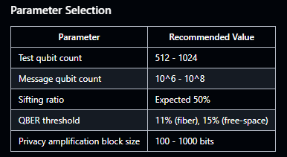
QUANTUM SECURE DIRECT COMMUNICATION (QSDC)
EGQCC
Information-Theoretic Security Proof
QSDC provides unconditional security through quantum mechanics. For a channel with QBER below Q_threshold, the mutual information between Eve's quantum state and the transmitted message is bounded.
The proof relies on:
If Eve measures test qubits, she introduces errors detectable with high probability
If Eve doesn't measure, she has zero information about bases
Privacy amplification ensures any residual information decays exponentially
Practical Implementation
Advantages Over Traditional Encryption
Single Protocol: Combines authentication, key establishment, and message transmission
No Key Storage: Eliminates persistent key vulnerability
Forward Secrecy: Historical messages remain secure even if current keys are compromised
Real-Time Detection: Eavesdropping is detected in real-time
Scalability: Message rate limited only by quantum source speed

Slide 28
QUANTUM SECURE DIRECT COMMUNICATION (QSDC)
EGQCC
QSDC Applications in Enterprise Security
Immediate Message Transmission
Scenario: Financial institution transmits sensitive transaction data.
QSDC Approach:
Perform security check (Phase 1-2)
Transmit transaction data directly via QSDC (Phase 3-4)
No keys need to be stored
Benefits:
Information-theoretically secure
No key management overhead
Real-time eavesdropping detection
Authentication in Quantum Networks
Scenario: Quantum repeater networks require authentication before QKD.
QSDC Solution: Use temporal authentication combined with QSDC for secure quantum repeater chain establishment.
Hybrid Classical-Quantum Enterprise Systems
Architecture:
Use QSDC for high-value, low-bandwidth secrets
Use traditional encryption for bulk data
Use QKD for periodic key refreshment

Slide 29
Thank you all

